Slide 1

SRES’s SHREE RAMCHANDRA COLLEGE OF ENGINEERING Lonikand, Pune – 412216 Department of Computer Engineering
A
Project Seminar
On
“Secure Data Transmission using Data Steganography with LSB Algorithm in Java”
Under the Guidance of Presented by
Prof.Yogita More 1) Shweta Chounde
2) Tanuja Dhere
3) Om Gaikwad
4) Zohaib Khan

Slide 2
SRES’s SHREE RAMCHANDRA COLLEGE OF ENGINEERING Lonikand, Pune – 412216 Department of Computer Engineering
INDEX
Introduction
Problem statement and objective.
Scope of Project
Literature survey
System Requirements
Limitation of Existing system
Project Approach
Plan
System Architecture
Social impact of project
Conclusions
References

Slide 3
SRES’s SHREE RAMCHANDRA COLLEGE OF ENGINEERING Lonikand, Pune – 412216 Department of Computer Engineering
INTRODUCTION
Data Steganography System – Enables secure communication by hiding confidential information within digital media such as images, audio, or video files, ensuring data secrecy and integrity.
Robust Security – Protects sensitive data from unauthorized access and cyber threats through advanced encryption and embedding techniques.
Efficiency & Accuracy – Automates the data-hiding process, reduces human error, and ensures accurate retrieval of hidden information without affecting media quality.
Better Confidential Communication – Strengthens secure data exchange between authorized users, ensuring privacy and trust in digital communication

Slide 4
SRES’s
SHREE RAMCHANDRA COLLEGE OF ENGINEERING
Lonikand, Pune – 412216
Department of Computer Engineering
PROBLEM STATEMENT
To develop and design a Secure Data Transmission System Using Data Steganography that is resilient to detection and extraction by unauthorized parties.

Slide 5
SRES’s SHREE RAMCHANDRA COLLEGE OF ENGINEERING Lonikand, Pune – 412216 Department of Computer Engineering
OBJECTIVES
To study and analyze existing methods of image and audio steganography.
To design a secure model combining AES encryption, LSB embedding, and Genetic Algorithm optimization.
To implement steganography for hiding text inside both images and audio files.
To ensure data integrity and imperceptibility of hidden content.
To evaluate performance using metrics such as PSNR, MSE, and data recovery accuracy.
To develop a user-friendly Java-based interface for encoding and decoding hidden messages.

Slide 6
SRES’s SHREE RAMCHANDRA COLLEGE OF ENGINEERING Lonikand, Pune – 412216 Department of Computer Engineering
SCOPE OF PROJECT
Secure Data Transmission:
  The project enables embedding secret information within digital media files (images, audio, or video) so that sensitive data can be transmitted without detection.
User Roles And Access:
  Sender: Can hide data using steganography techniques.
Receiver: Can extract hidden information using correct key.
Supported Media Formates :
  The system will support common media formats such as JPEG, PNG, WAV, and MP4 for embedding and extraction of hidden data.
Security :
  Advanced algorithms (e.g., LSB or PCA-based methods) will be used to ensure that the hidden data remains secure and intact without noticeable changes in media quality.

Slide 7
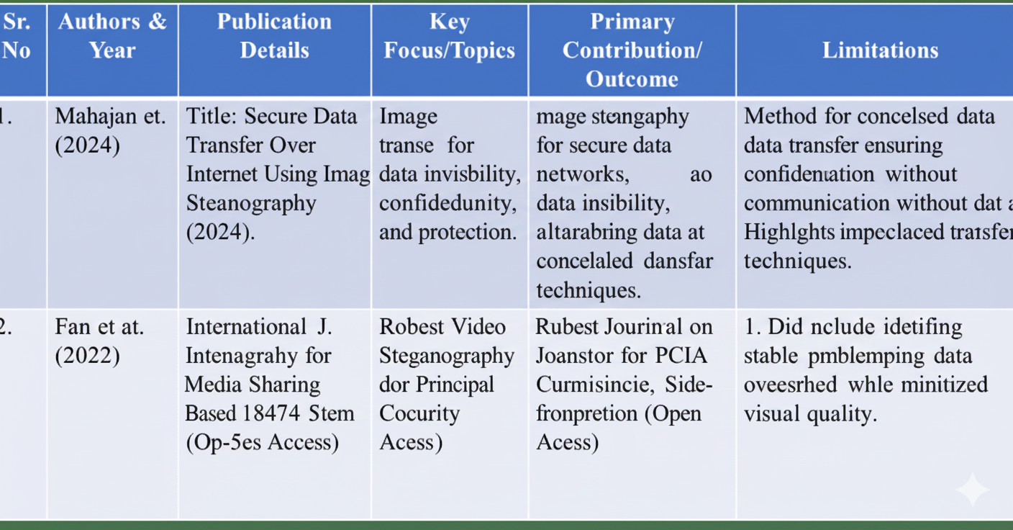
SRES’s SHREE RAMCHANDRA COLLEGE OF ENGINEERING Lonikand, Pune – 412216 Department of Computer Engineering
LITERATURE SURVEY

Slide 8
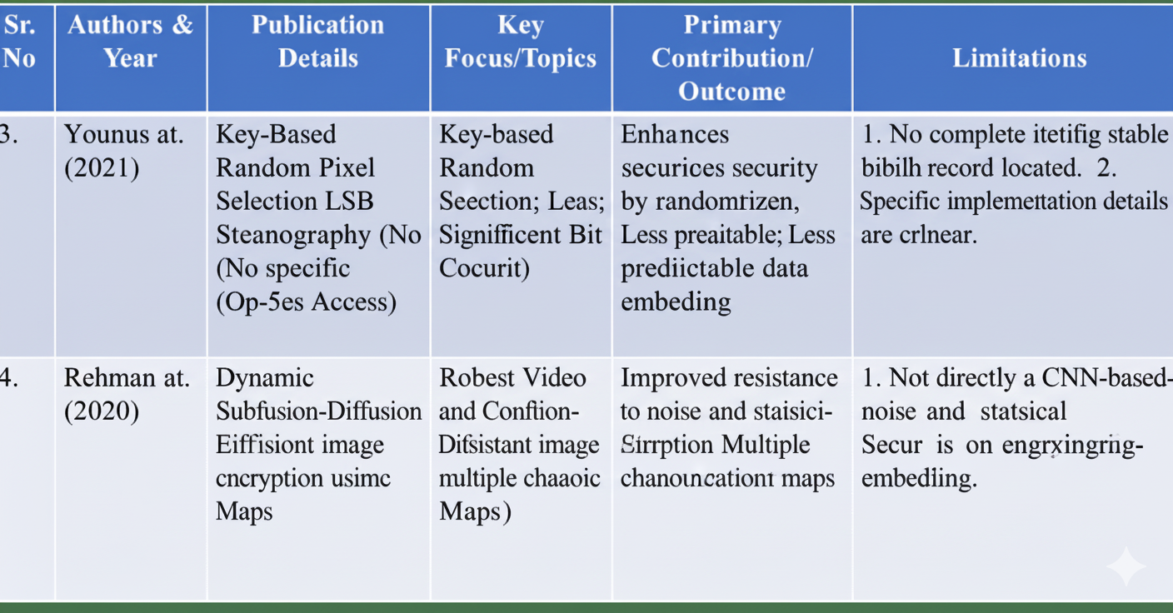
SRES’s SHREE RAMCHANDRA COLLEGE OF ENGINEERING Lonikand, Pune – 412216 Department of Computer Engineering
LITERATURE SURVEY

Slide 9
SRES’s SHREE RAMCHANDRA COLLEGE OF ENGINEERING Lonikand, Pune – 412216 Department of Computer Engineering
SYSTEM REQUIREMENTS
Software Requirements
Software Programming Language: Java
JDK Version: 21
IDE: IntelliJ IDEA
GUI Toolkit: Java Swing
Key Libraries:
  javax.swing (GUI)
  java.util (Data Structures)
  java.io (File I/O)
  java.sql (Database for user profiles)

Slide 10
SRES’s SHREE RAMCHANDRA COLLEGE OF ENGINEERING Lonikand, Pune – 412216 Department of Computer Engineering
Hardware Requirements
Hardware & UI Hardware Requirements:
  Processor: Core i5 or higher
  RAM: 8GB
  Hard Disk: 500 GB
User Interface:
  Built using Java Swing.
  Provides forms for:
    User Registration & Login
    Image/Audio Encoding & Decoding
    Sending encoded files via Email.

Slide 11
SRES’s SHREE RAMCHANDRA COLLEGE OF ENGINEERING Lonikand, Pune – 412216 Department of Computer Engineering
LIMITATION OF EXISTING SYSTEM
File Size Constraints : Large files may slow down the embedding and extraction process, and excessive data embedding may degrade media quality.
Format Restrictions : The system may support only specific file formats (e.g., JPEG, PNG, WAV, MP4) for embedding, limiting compatibility.
Requirement for Compatible Tools : Both sender and receiver must use compatible embedding and extraction tools for successful communication.
Risk Detection : Advanced steganalysis tools can detect the presence of hidden data, which may compromise secrecy.

Slide 12
SRES’s SHREE RAMCHANDRA COLLEGE OF ENGINEERING Lonikand, Pune – 412216 Department of Computer Engineering
PROPOSED APPROACH
User : Provide text, image and audio as input.
Frame Extraction: Extract optimal frames from media for embedding.
LSB Labeling: Convert data to binary and embed using Least Significant Bit technique.
Steganography Embedding: Hide encrypted data into selected frames.
Output: Generate encoded image/audio with hidden text for secure sharing.

Slide 13
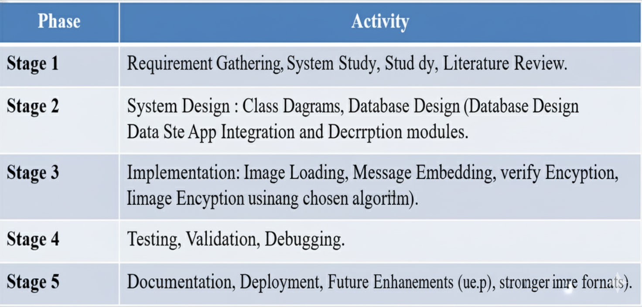
SRES’s SHREE RAMCHANDRA COLLEGE OF ENGINEERING Lonikand, Pune – 412216 Department of Computer Engineering
PROJECT PLAN

Slide 14
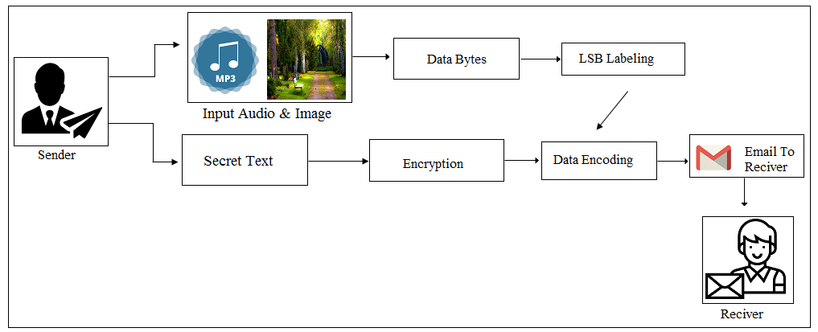
SRES’s SHREE RAMCHANDRA COLLEGE OF ENGINEERING Lonikand, Pune – 412216 Department of Computer Engineering
SYSTEM ARCHITECTURE

Slide 15
SRES’s SHREE RAMCHANDRA COLLEGE OF ENGINEERING Lonikand, Pune – 412216 Department of Computer Engineering
SOCIAL IMPACT OF PROJECT
Enhances privacy and security in digital communication.
protects sensitive data from unauthorized access.
promotes awareness of cybersecurity and safe data sharing.
supports secure sharing of confidential information in education healthcare, and business.
and encourages the adoption of advanced steganography and encryption techniques

Slide 16
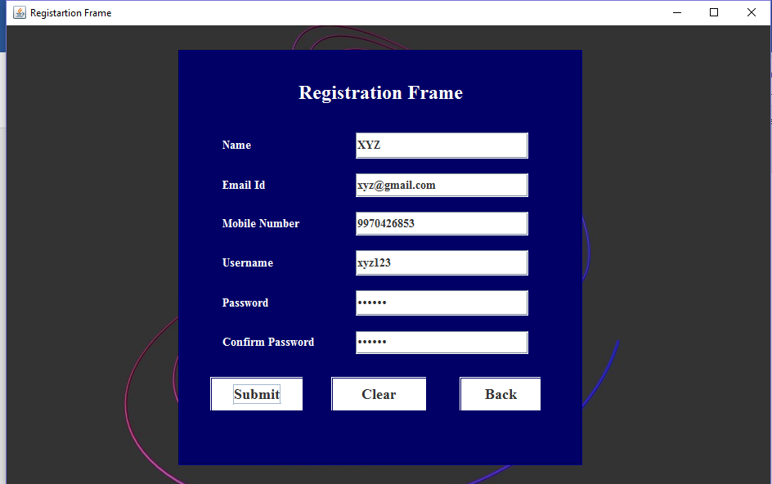
SRES’s SHREE RAMCHANDRA COLLEGE OF ENGINEERING Lonikand, Pune – 412216 Department of Computer Engineering
RESULT

Slide 17
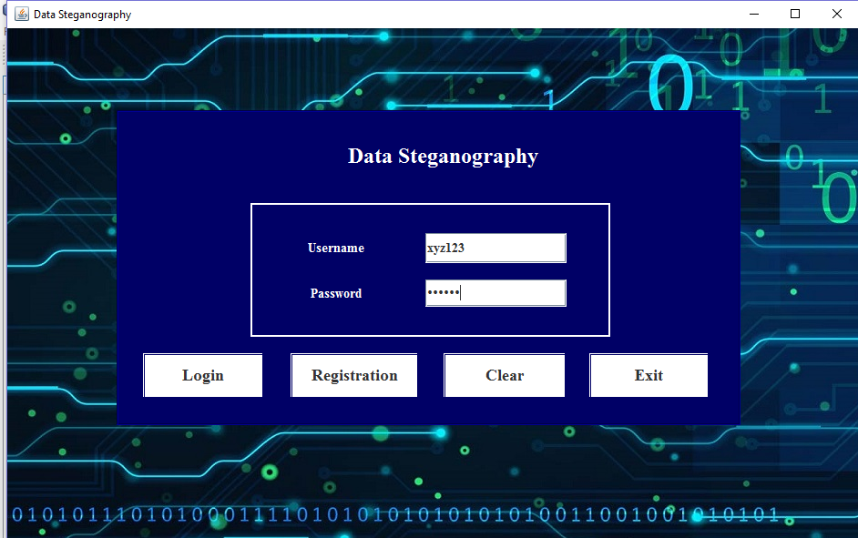
SRES’s SHREE RAMCHANDRA COLLEGE OF ENGINEERING Lonikand, Pune – 412216 Department of Computer Engineering

Slide 18
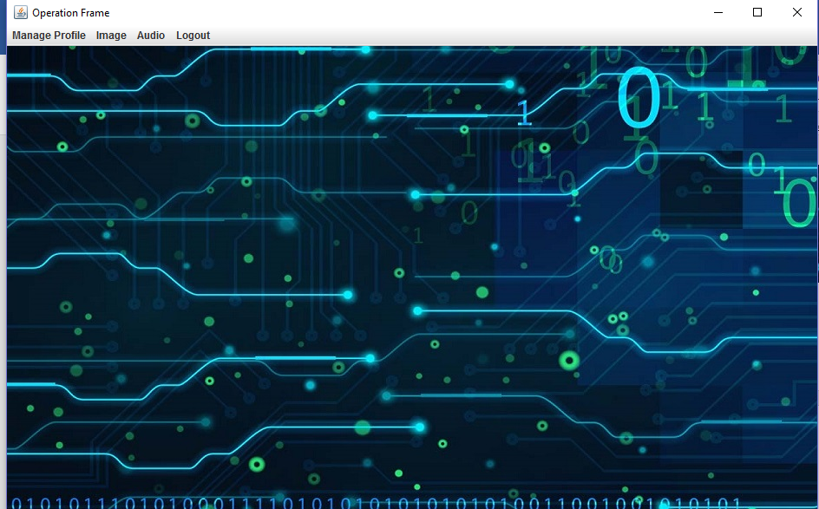
SRES’s SHREE RAMCHANDRA COLLEGE OF ENGINEERING Lonikand, Pune – 412216 Department of Computer Engineering

Slide 19
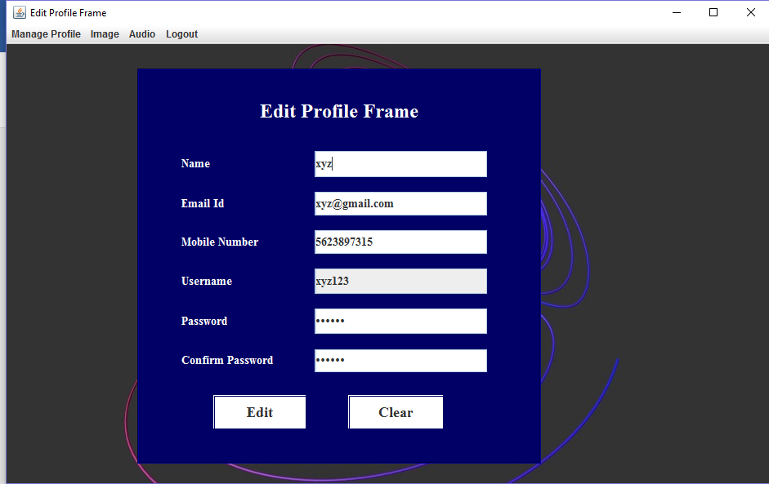
SRES’s SHREE RAMCHANDRA COLLEGE OF ENGINEERING Lonikand, Pune – 412216 Department of Computer Engineering

Slide 20
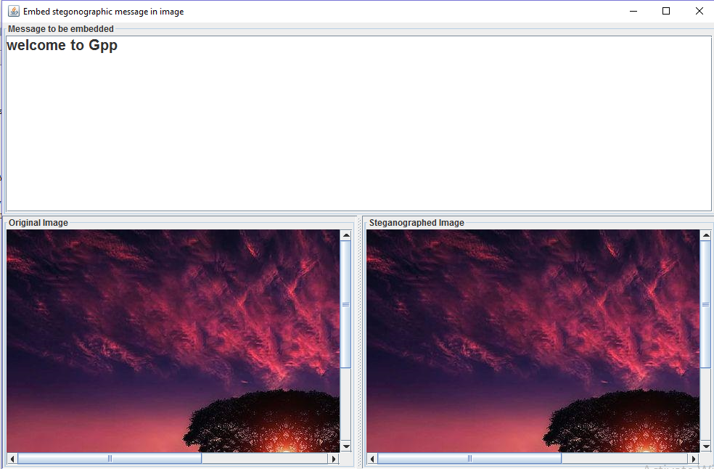
SRES’s SHREE RAMCHANDRA COLLEGE OF ENGINEERING Lonikand, Pune – 412216 Department of Computer Engineering

Slide 21
SRES’s SHREE RAMCHANDRA COLLEGE OF ENGINEERING Lonikand, Pune – 412216 Department of Computer Engineering
REFERENCES
Islam, A. U. (2018). An Improved Image Steganography Technique Based on MSB Using Bit Differencing. INTECH Conference.
Rehman, M. (2020). Deep Learning-Based Image Steganography Using CNN Encoder-Decoder Framework. IEEE Access.
Younus, M. (2021). Enhanced LSB Video Steganography Using Key Functional Technique. International Journal of Information Security.

Slide 22
SRES’s SHREE RAMCHANDRA COLLEGE OF ENGINEERING Lonikand, Pune – 412216 Department of Computer Engineering
CONCLUSION
  Successfully developed a unified application for secure data hiding in images and audio.
  The hybrid approach (AES + LSB) enhances security and optimizes embedding.
  The system is user-friendly, with a complete GUI for all operations from login to transmission.
  This project provides a robust tool for secure and covert communication, mitigating risks of data theft.

Slide 23

SRES’s SHREE RAMCHANDRA COLLEGE OF ENGINEERING Lonikand, Pune – 412216 Department of Computer Engineering

